Slide 1


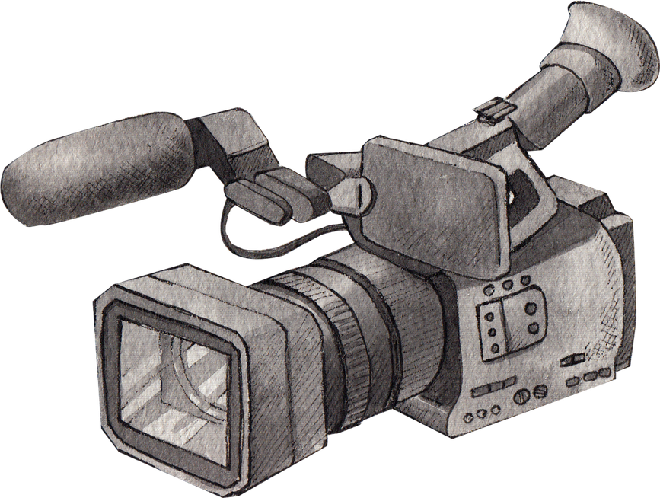


Cinema: History, Art & Influence
by Dr Salma

Slide 2
What Makes a Film Great?
What is the best film you have ever seen?
What matters more: story or visuals?
Do awards define quality?
Pick a movie from the list below or one from your mind:
The Godfather
Citizen Kane
Avatar
“The Pursuit of Happyness”
Interstellar
And provide reasons for why you liked it or why this movie is considered one of the best.

Slide 3
The History of Cinema
01.
02.
Early cinema (silent films, black & white)
Golden Age of Hollywood
Color & sound revolution
Digital cinema
Pick one era and present it to your colleagues:
Identify major developments?
What changed audience experience?
Which era had the biggest impact?
Notes:
Watch the video afterwards https://www.reddit.com/r/movies/comments/58o5nz/hugo_history_of_georges_m%C3%A9li%C3%A8s/

Slide 4
Reading
What were the key developments that shaped early cinema?
Why was the silent film era important for cinematic storytelling?
How did sound change the film industry?
Why is Citizen Kane considered influential?
Critical Thinking
Do you think modern cinema is better than early cinema? Why or why not?
Has technology improved storytelling, or has it made films less creative?
What if sound had never been introduced in films? How would cinema be different?
Do streaming platforms threaten traditional cinema or improve it?
Notes:
1. The key developments included the invention of the motion picture camera, early film screenings by Auguste Lumière and Louis Lumière, and the transition from still images to moving visuals. These innovations introduced audiences to a new form of storytelling based on motion and visual representation.
2. The silent film era was important because it emphasized visual storytelling, including facial expressions, body language, and cinematography. Filmmakers had to communicate emotions and narratives without dialogue, which strengthened the artistic and expressive aspects of cinema.
3. Sound revolutionized cinema by introducing dialogue, music, and sound effects, making films more realistic and emotionally engaging. Movies like The Jazz Singer marked the shift to “talkies,” which transformed storytelling and audience experience.
4. Citizen Kane is considered influential because of its innovative cinematography, narrative structure, and use of techniques such as deep focus and non-linear storytelling. It set new standards for filmmaking and continues to influence modern cinema.
5. Modern cinema is more advanced in terms of technology and visual effects; however, early cinema was often more innovative in storytelling. While today’s films may be more visually impressive, earlier films relied heavily on creativity and originality. Therefore, both periods have unique strengths.
6. Technology has improved storytelling by allowing filmmakers to create more immersive and visually complex narratives. However, it can sometimes reduce creativity if filmmakers rely too heavily on special effects instead of strong scripts and character development.
7. If sound had never been introduced, cinema would rely entirely on visual storytelling, similar to the silent film era. This might lead to more artistic and expressive filmmaking, but it would limit realism and emotional depth created through dialogue and sound.
8. Streaming platforms both challenge and improve traditional cinema. They make films more accessible to global audiences, but they may reduce the popularity of movie theaters. Overall, they are transforming the industry rather than completely replacing it.

Slide 5
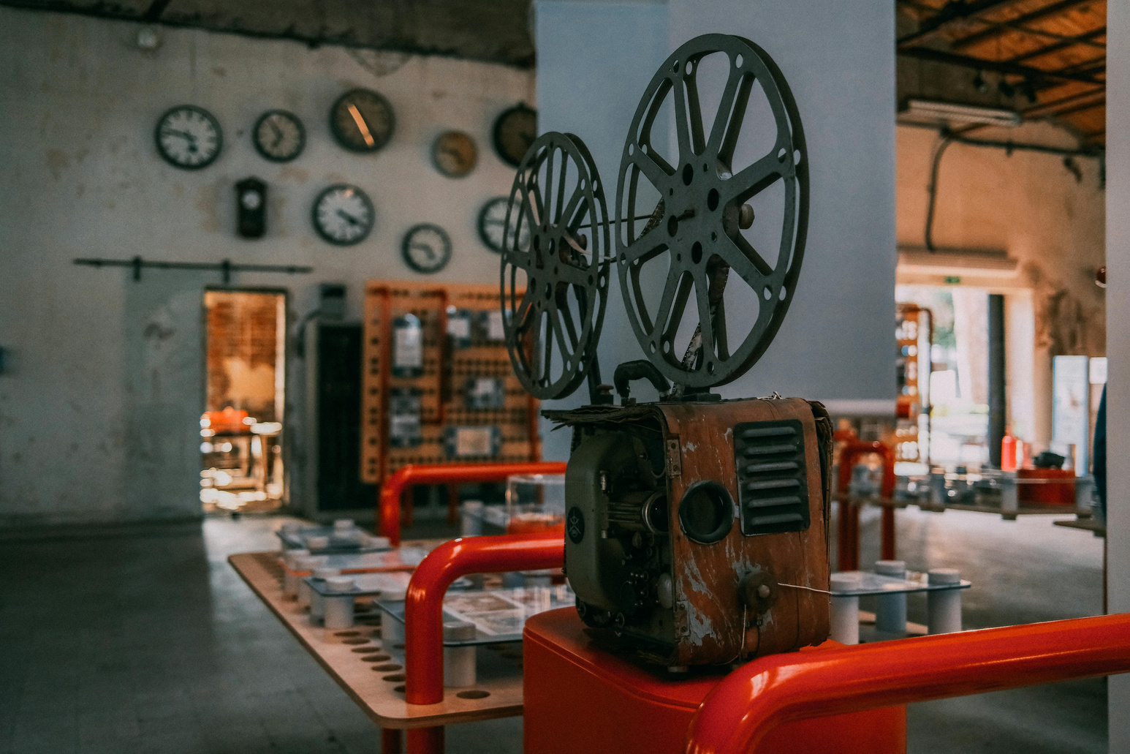
Vocabulary & Cinematography
Key Terms:
cinematography
mise-en-scène
lighting
framing
camera movement
symbolism
Provide a definition for each. Then, describe a scene using these terms.
Notes:
Cinematography
Definition:
Cinematography is the art and technique of capturing visual images in film, including camera work, lighting, composition, and movement to tell a story.
Example:
“The cinematography in Inception enhances the dream-like atmosphere.”
“Good cinematography can communicate emotions without dialogue.”
Mise-en-scène
Definition:
Mise-en-scène refers to everything visible within a scene, including setting, costumes, props, lighting, and actors’ positioning.
Example:
“The mise-en-scène in The Grand Budapest Hotel is carefully designed to create a unique visual style.”
“The dark room and minimal furniture create a tense mise-en-scène.”
Lighting
Definition:
Lighting is the use of light and shadow in a film to create mood, highlight characters, or influence how a scene is perceived.
Example:
“Low lighting creates suspense and mystery.”
“The bright lighting in La La Land reflects a joyful atmosphere.”
Framing
Definition:
Framing is the way elements are arranged within the camera shot, determining what the audience sees and how they interpret it.
Example:
“The character is placed in the center of the frame to show importance.”
“Tight framing creates a feeling of pressure or isolation.”
Camera Movement
Definition:
Camera movement refers to how the camera moves during a shot, such as panning, tilting, tracking, or zooming, to guide the viewer’s attention.
Example:
“A slow zoom increases tension.”
“The tracking shots in Goodfellas create a sense of realism.”
Symbolism
Definition:
Symbolism is the use of objects, colors, or visual elements to represent deeper meanings or ideas beyond their literal sense.
Example:
“The color red symbolizes danger or passion.”
“In The Matrix, the red pill represents truth and awakening.”

Slide 6
GUESS THE MOVIE

Slide 7
Cinematography in Action
Watch a breakdown video of a film scene.
Identify techniques
Explain emotional impact
Analyze director’s intention
Notes:
https://www.youtube.com/watch?v=rCZ3SN65kIs
https://youtu.be/8F4ONbCPMyU?si=o833fY-eiEEQ44ZZ

Slide 8
Scene Analysis
1
2
Analyze a scene:
Focus on:
lighting
camera angles
acting
sound
Examples:
Titanic
Lord of the Rings
Harry Potter
300
or any movie you want to pick.

Slide 9
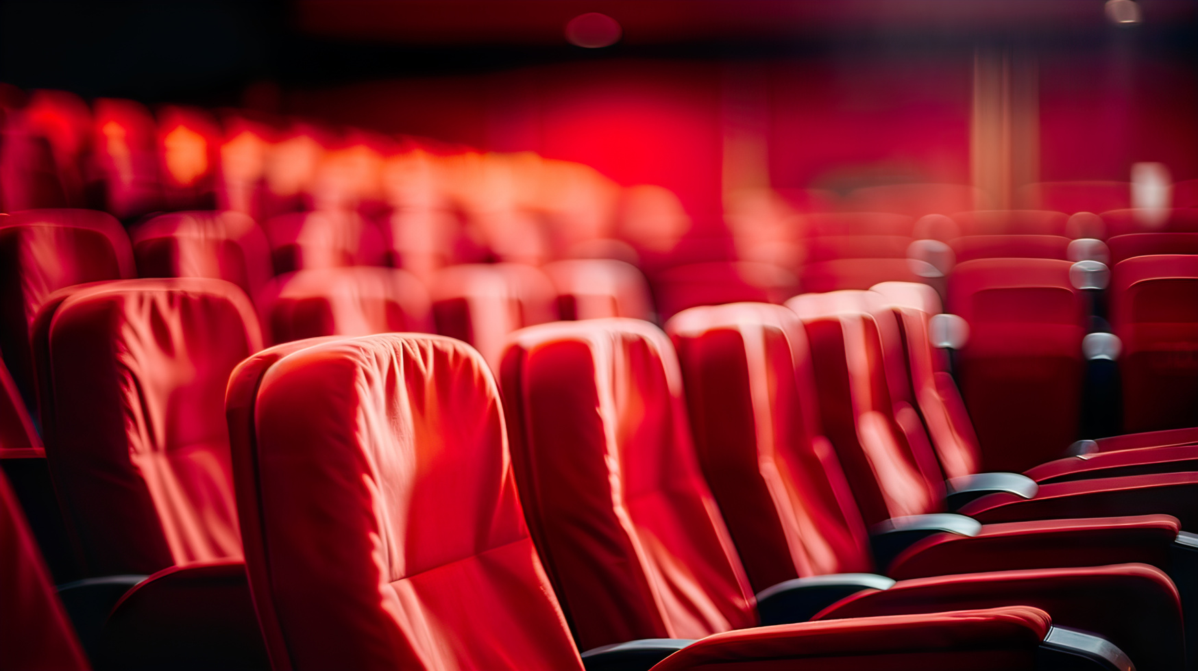
Debate
“Old films are more artistic than modern films.” Do you agree?
“Technology is more important than storytelling in cinema today.” Discuss.
“Cinematography is more important than storytelling.”

Slide 10
Film Scene Interpretation
What emotions are conveyed?
How do visuals support the story?
Provide a similar Example
Notes:
https://youtu.be/b66gLKLU8yU?si=XNz6TRlvdmTKNI6d

Slide 11
Film Industry Panel
Roles:
director
critic
producer
audience
Task:
Discuss:
What makes a film successful?
How should films be evaluated?

Slide 12
Writing Task
Option 1: Film Review
Analyze a movie.
Option 2: Essay
“What defines a great film?”
Requirements:
250–300 words

Slide 13
Create the Greatest Film Ever!
Students design a film:
Include:
genre
storyline
cinematography style
target audience
Present to class.

Slide 14
THANK YOU

